Slide 1




Data Mining
Team – Kanya Rasi
Aravind Teja Chikoti
Nagarjuna Chidarala
Sohan Kumar Sahoo

Slide 2
Objective
To predict firm collapse/bankruptcy
Dataset Description
Profitability metrics
Net profit to Total assets
EBIT to total assets ratio
Liquidity metrics
Working capital to Total assets
Current assets to short term liabilities

Slide 3
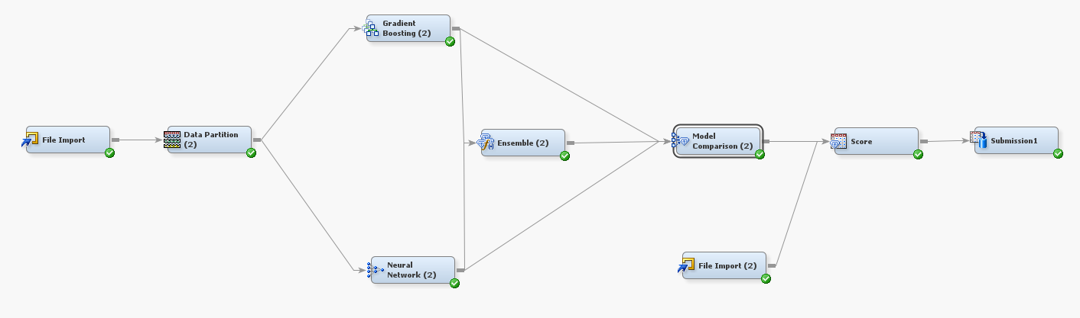
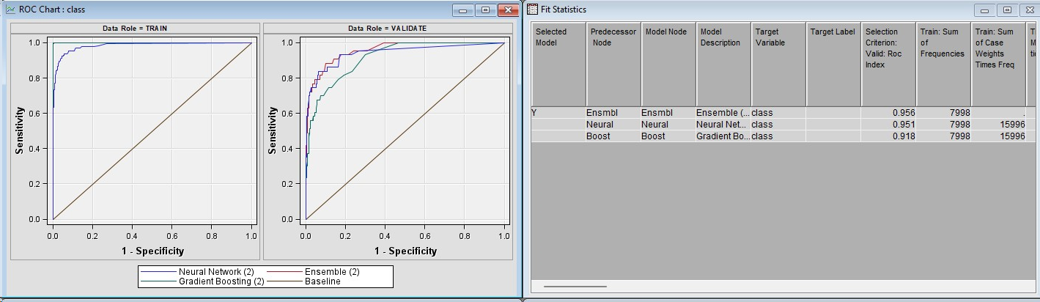
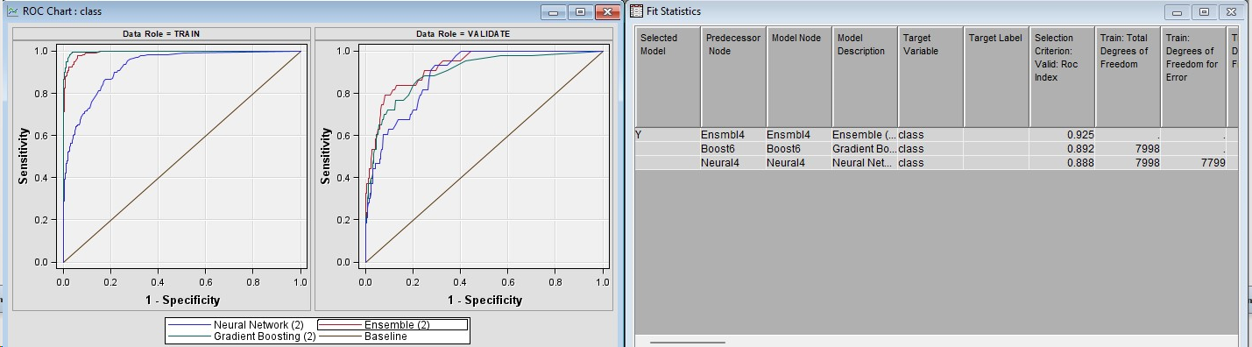
Final Model

Slide 4
Methodology
Sampling
Exploration
Modification
Modelling
Assessing

Slide 5
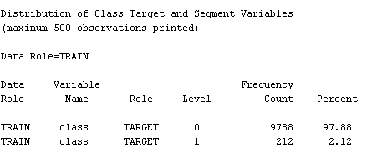
Exploration
Distribution of target variable is highly imbalanced
97.88% of the observations in the target class 0
2.12% of the observations in the target class 1
No null values

Slide 6
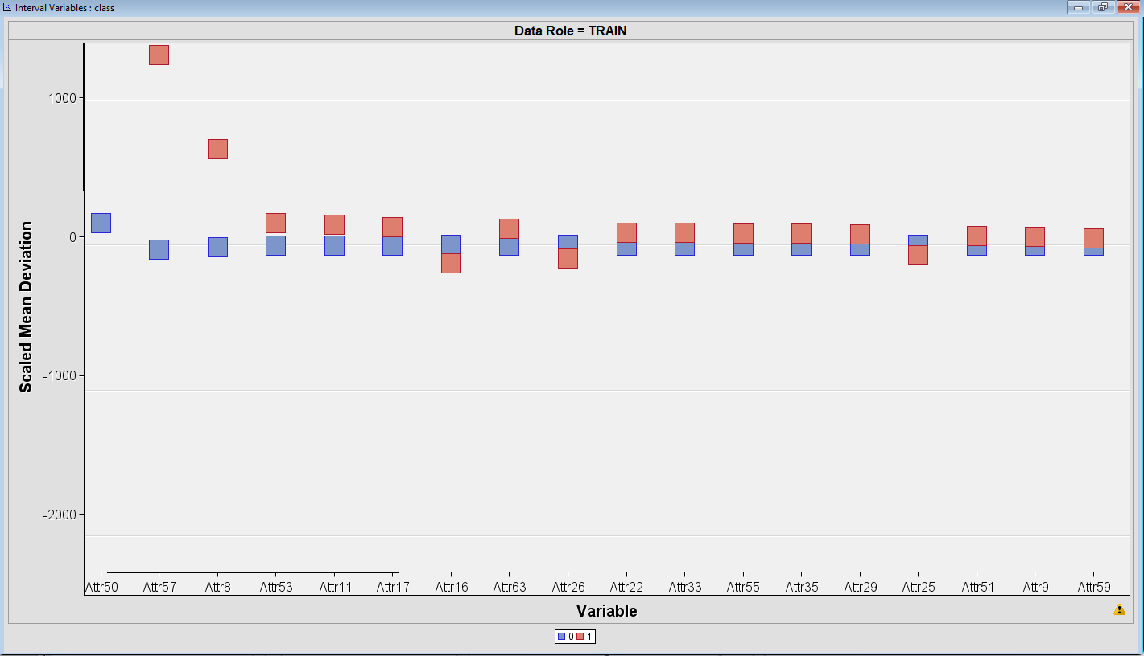
Exploration continued
Higher the difference more important in terms of their influence on the classification outcome
These variables may be more informative or discriminative for distinguishing between classes

Slide 7
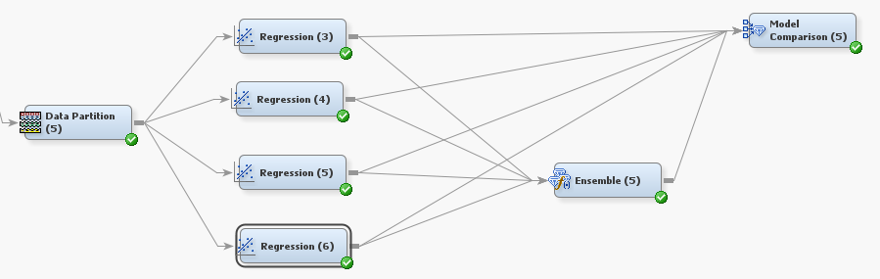
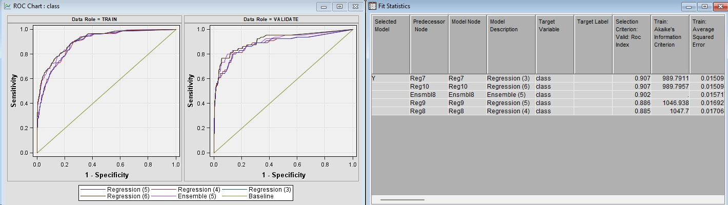
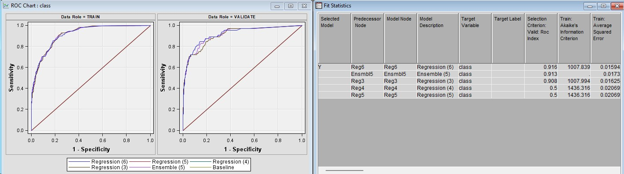
Regression Model
Type | Interaction Terms
Backward | No
Forward | No
Stepwise | No

Slide 8
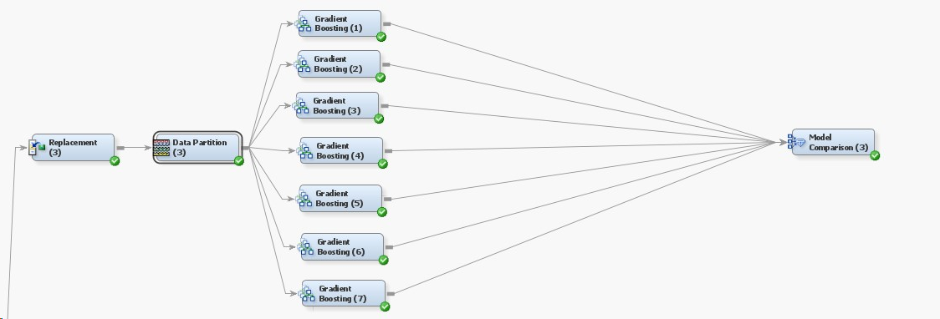
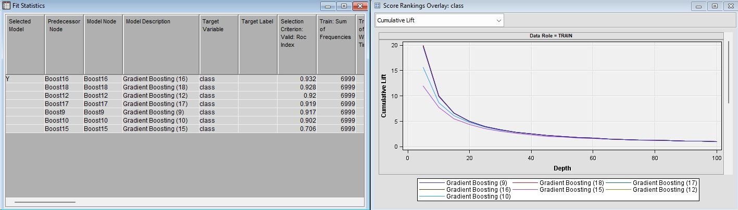
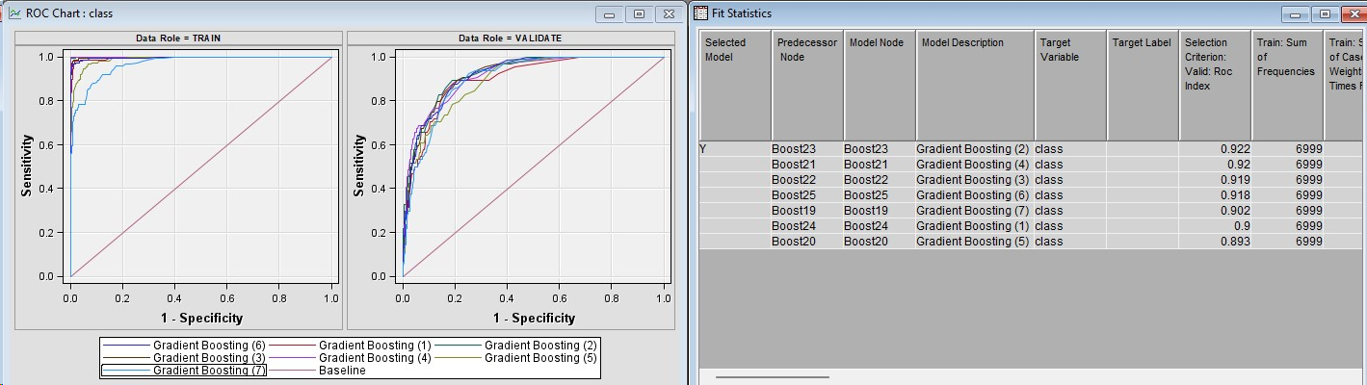
Gradient Boosting
Iterations | Shrinkage | Depth
120 | 0.05 | 6
100 | 0.06 | 8
90 | 0.07 | 8
80 | 0.08 | 8
70 | 0.07 | 8
60 | 0.09 | 8
50 | 0.1 | 6

Slide 9
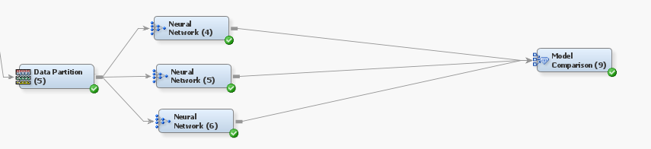
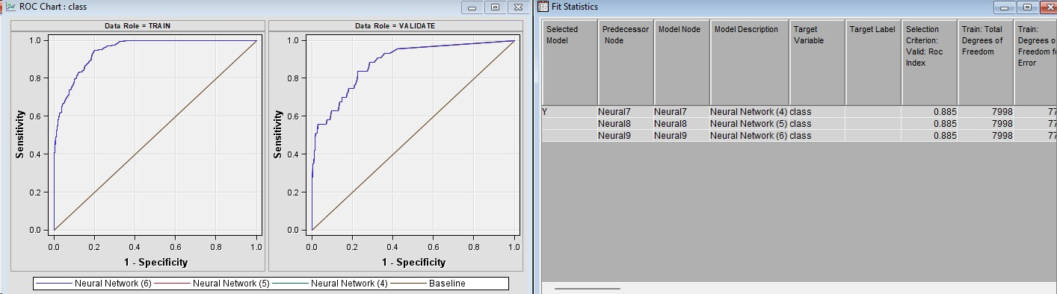
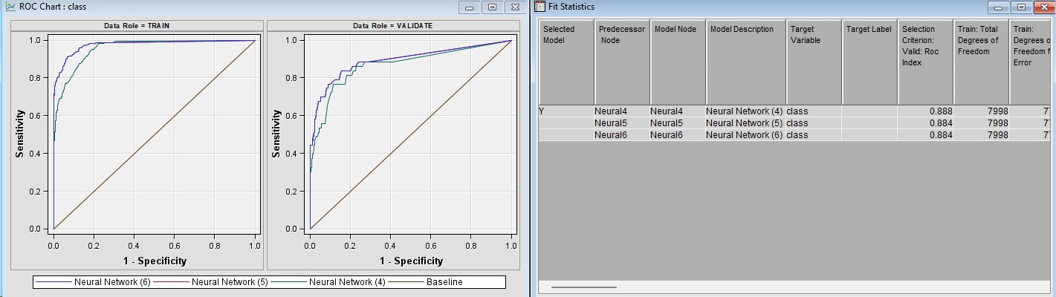
Neural Network
Iterations
50
200
167

Slide 10
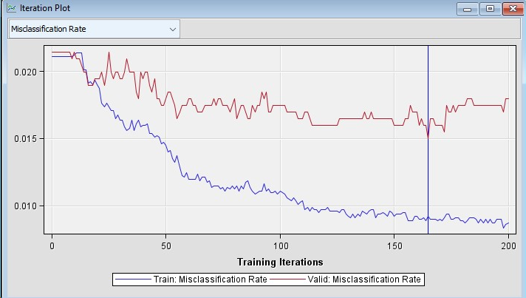
Iterations with less misclassification rate for Neural Network
Neural Network was run at high iterations to find the optimal point where misclassification rate is low for both Training and Validation set. We have received the optimal iterations as 167.

Slide 11

Ensemble
The Ensemble node creates new models by combining the posterior probabilities (for class targets) or the predicted values (for interval targets) from multiple predecessor models. The new model is then used to score new data.
The Ensemble node uses the following methods to combine results from different modeling nodes.
Average
Maximum
Voting

Slide 12
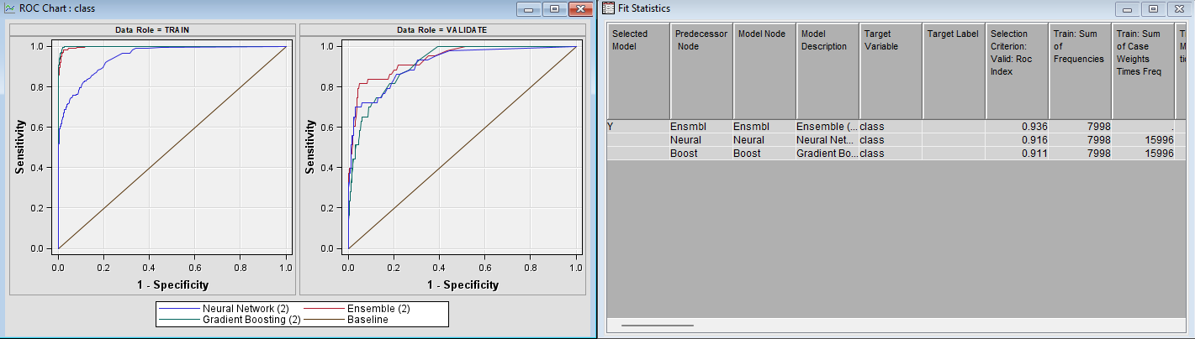
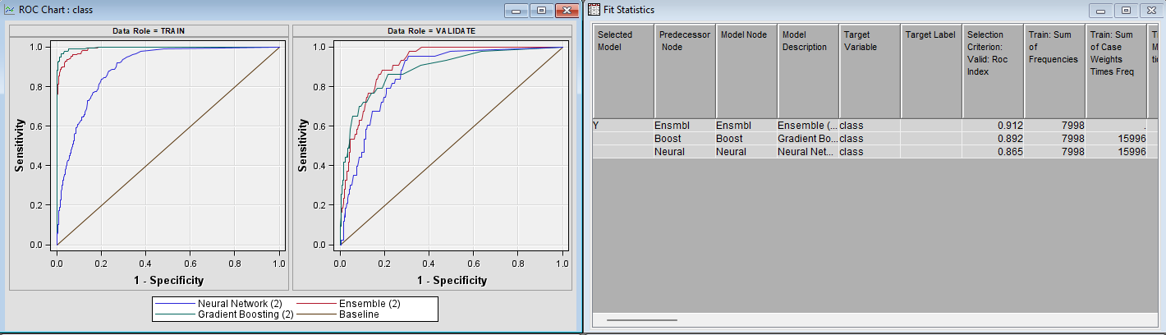
Variable selection

Slide 13
Final Model

Slide 14
Thank you

